Slide 1
Operating System
Os scheduling

Slide 2
Team Fullstack
17201012 : Rashik Rahman
17201046 : Mariam Rahman
17201039 : Abdul Fattah Rakib

Slide 3
OUTLINE
FCFS
SJF
Priority Scheduling

Slide 4
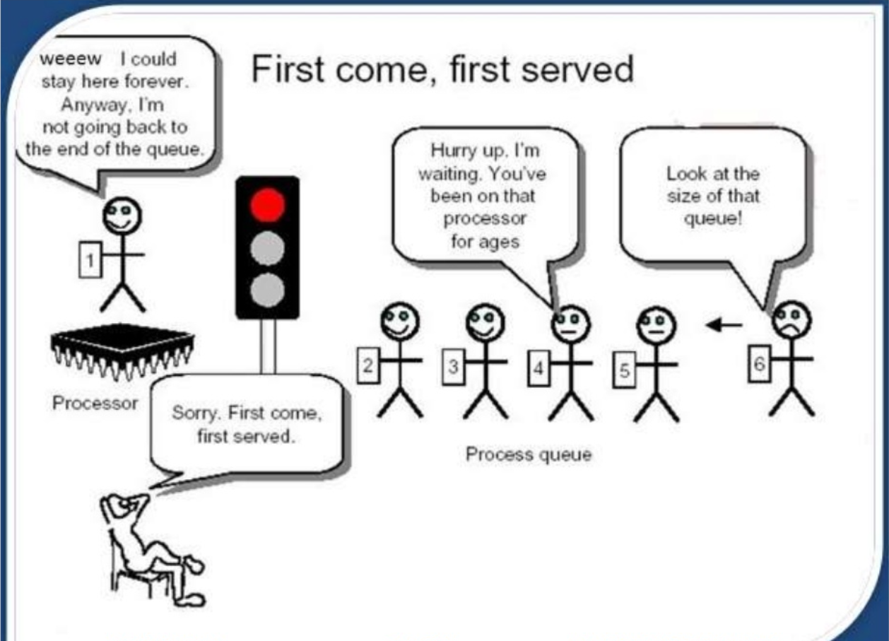

Slide 5
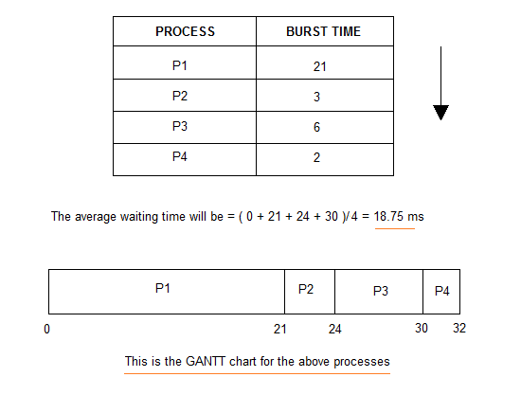

Slide 6
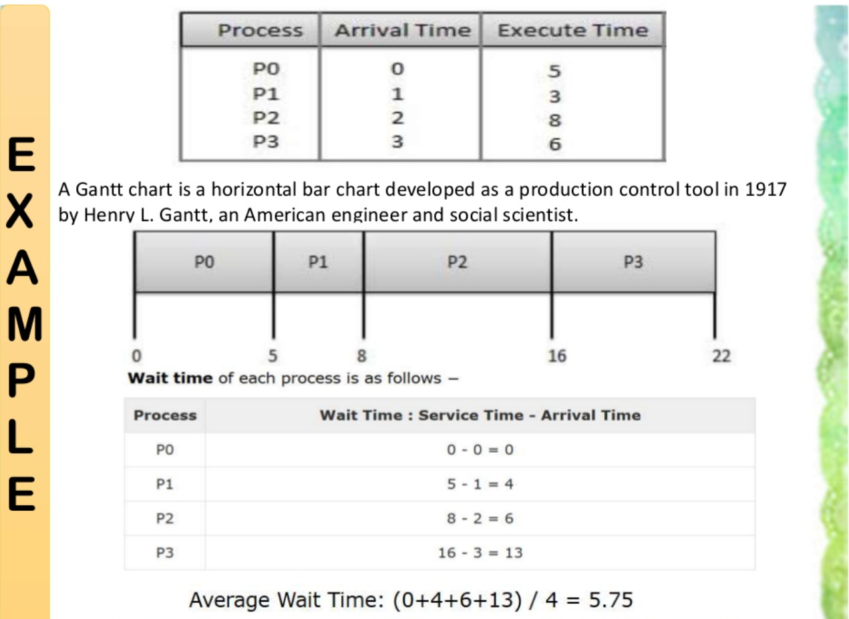

Slide 7
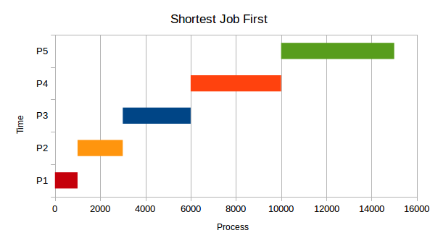

Slide 8
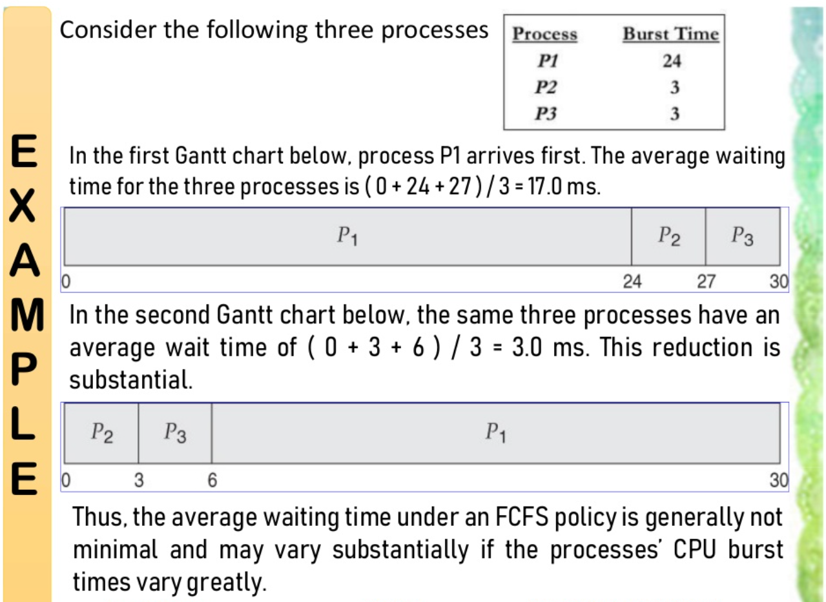

Slide 9
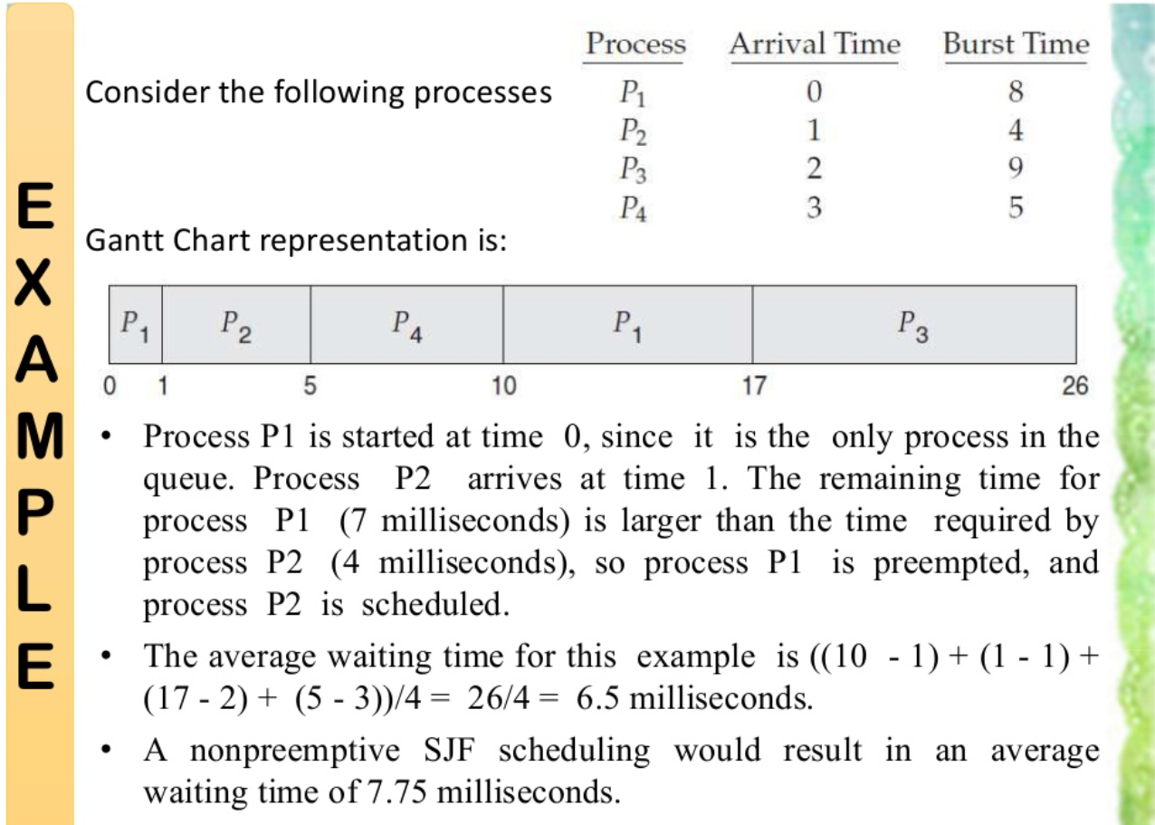

Slide 10
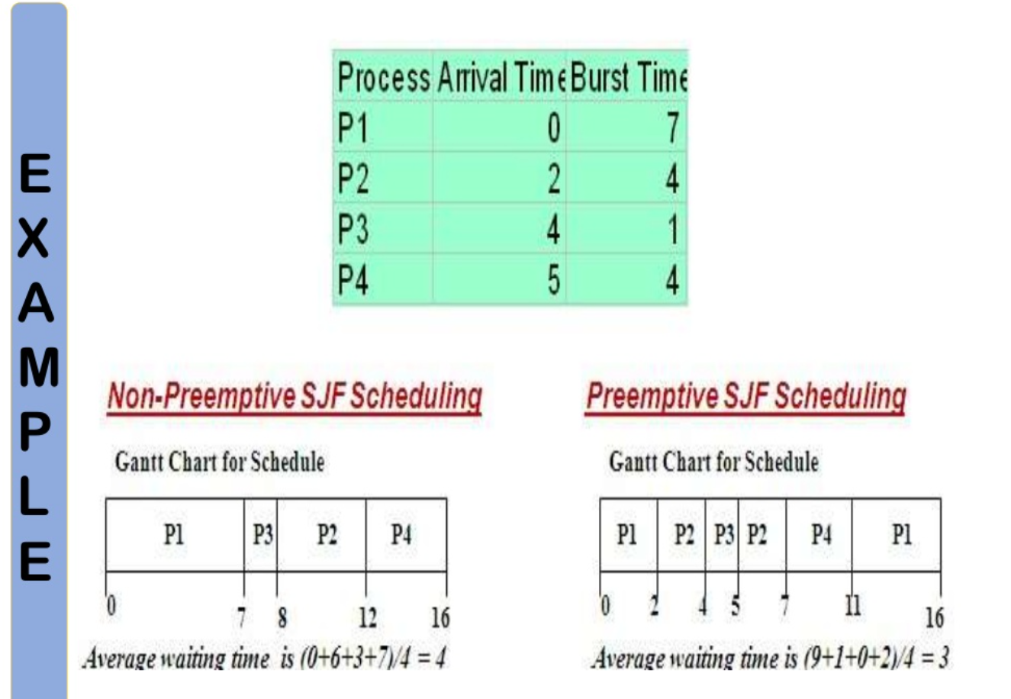

Slide 11
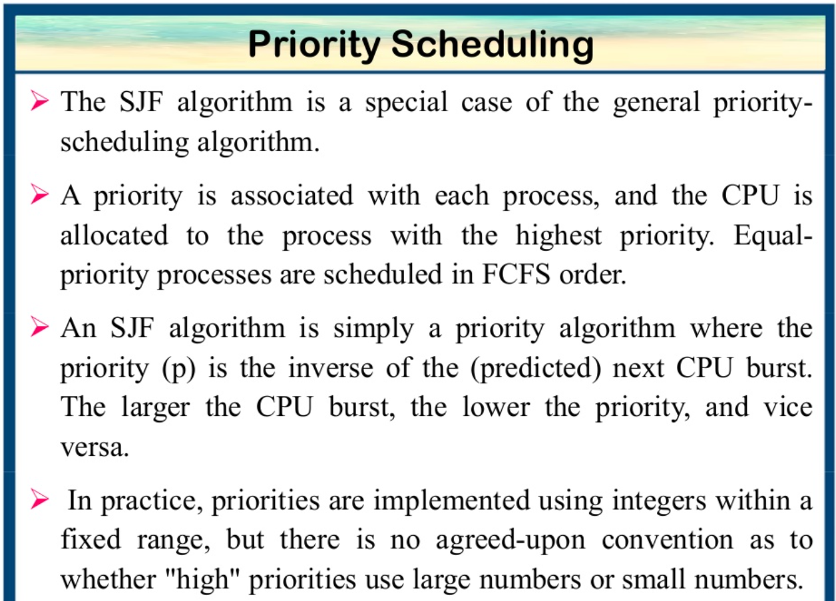

Slide 12
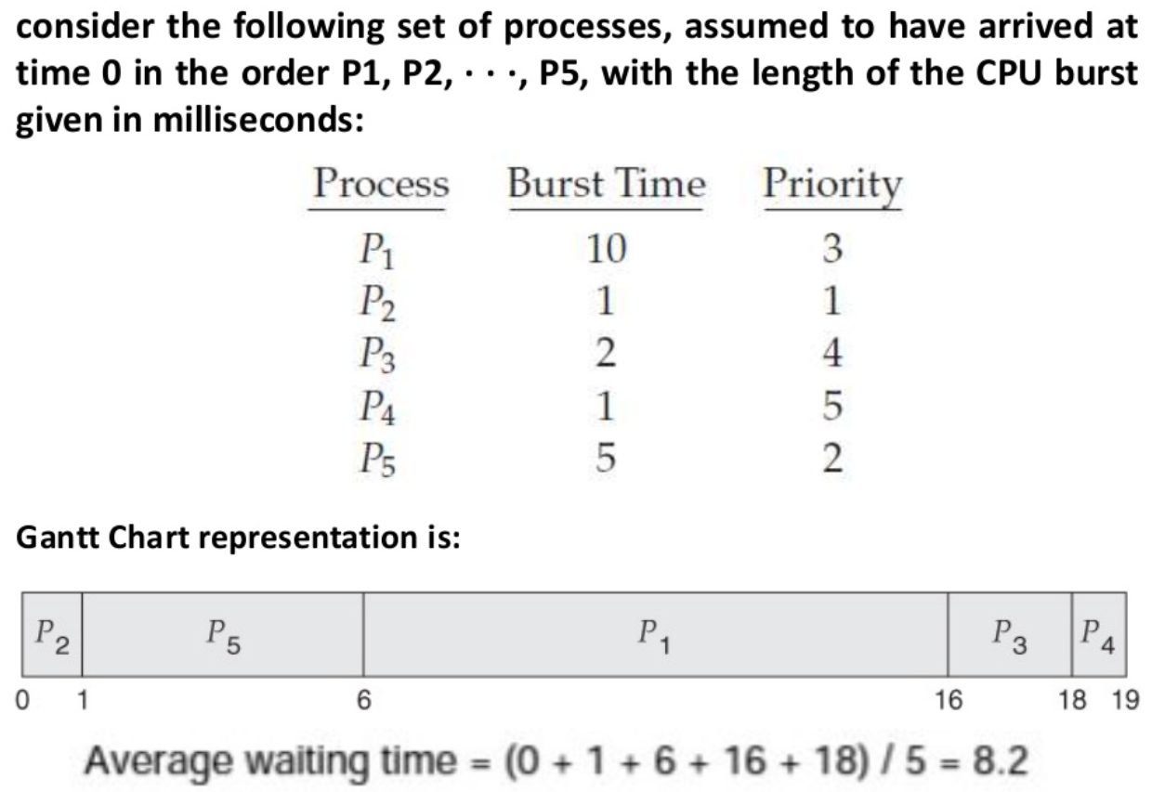

Slide 13
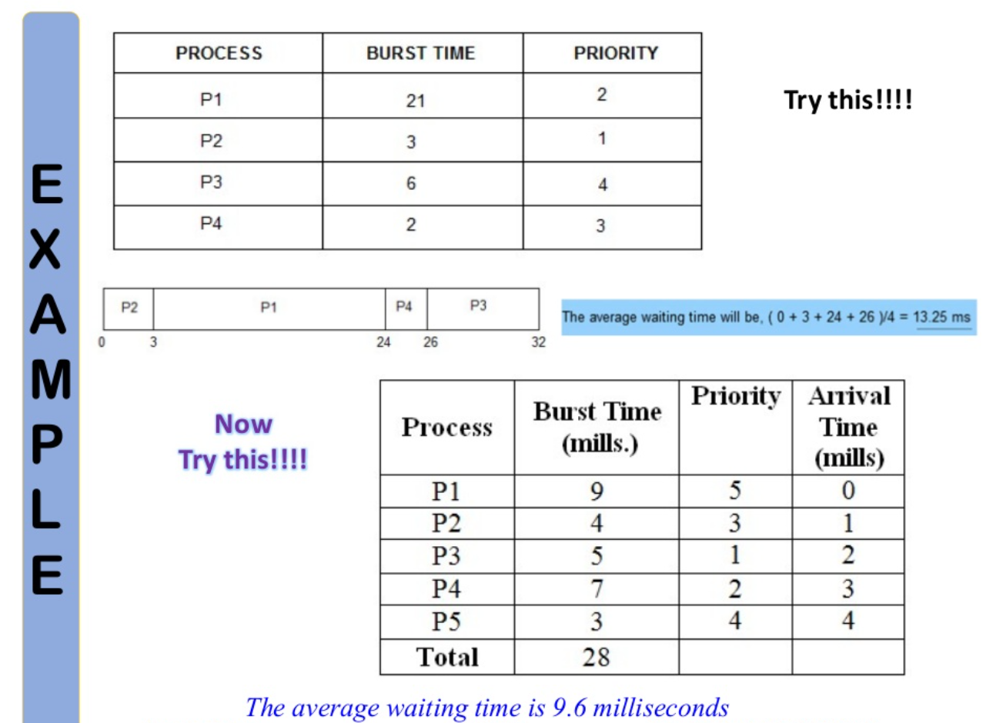

Slide 14
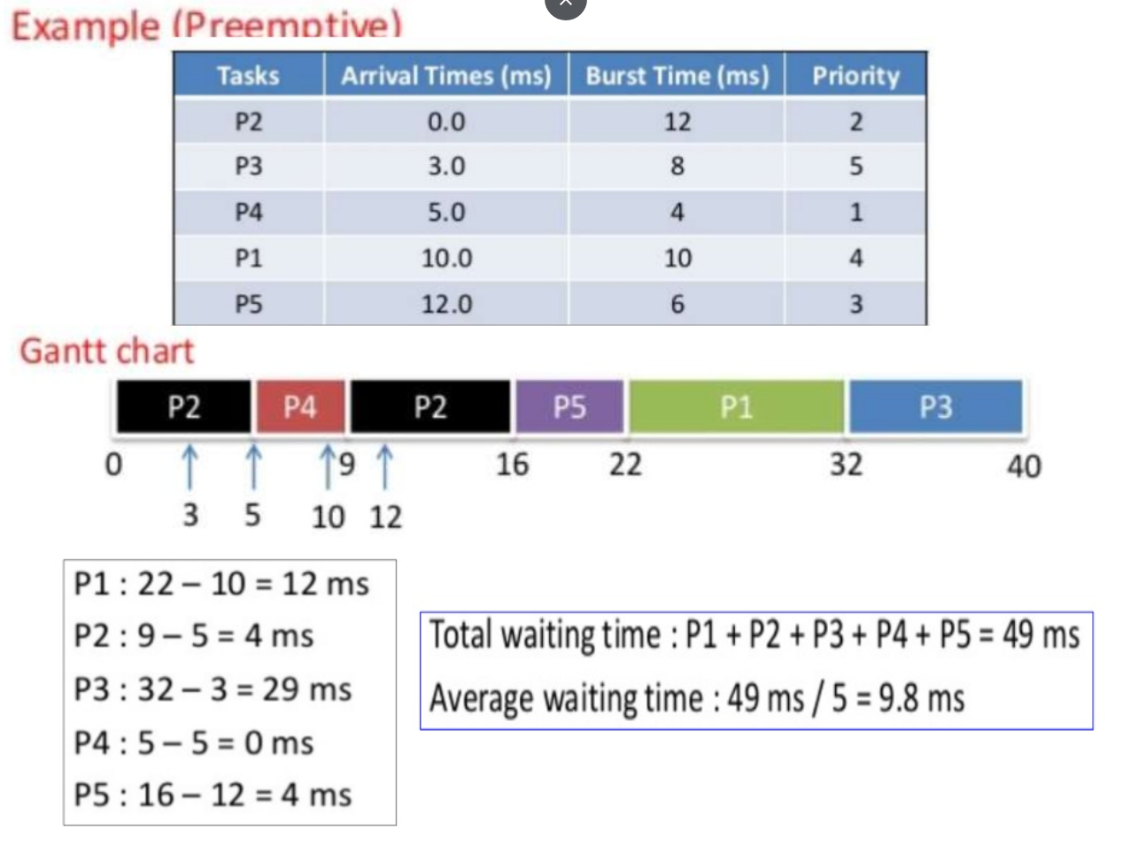

Slide 15
Any Questions?
Thank you!

